Slide 1

Introduction to Data Visualisation and Analysis with PowerBI

Slide 2

Learning Objective
Find out what is PowerBI
Learn how to setup PowerBI
Get Some Data (csv, xls, web)
Basic Manipulation (inc calcs and joining data)
Visualise
Interact

Slide 3
Poll
PowerBI users
Excel users
Advanced Excel users who complex reporting. e.g. multiple sheets, lots of expressions, vlookup, pivot & charts

Slide 4

Poll
Curious about Data Viz
Have a requirement to visualise or analyse some data.
Power BI user wanting to know more

Slide 5
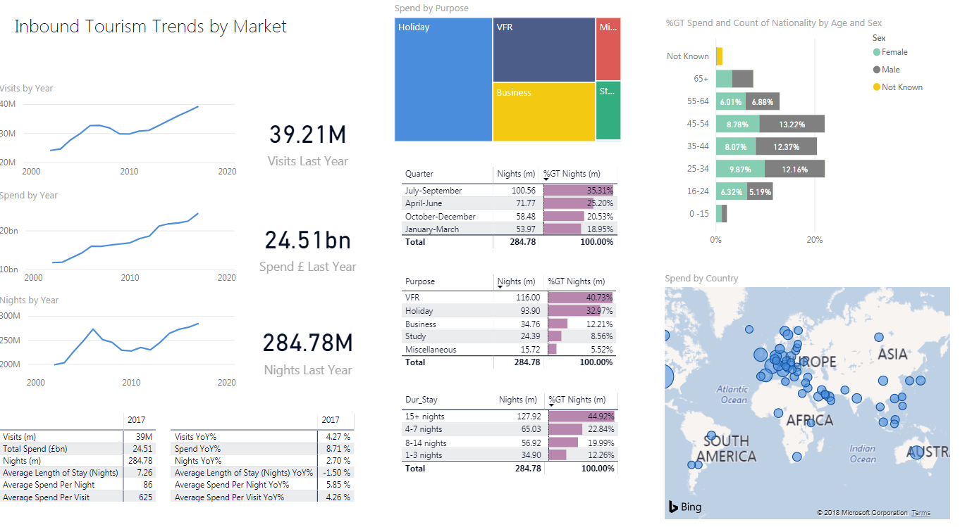
Power BI
What is Power BI
“Bring your data to life”
“Microsoft Power BI transforms your company's data into rich visuals for you to collect and organize so you can focus on what matters to you. Stay in the know, spot trends as they happen, and push your business further”
“Your data your way”
Power BI is a suite of business analytics tools to analyse data and share insights

Slide 6
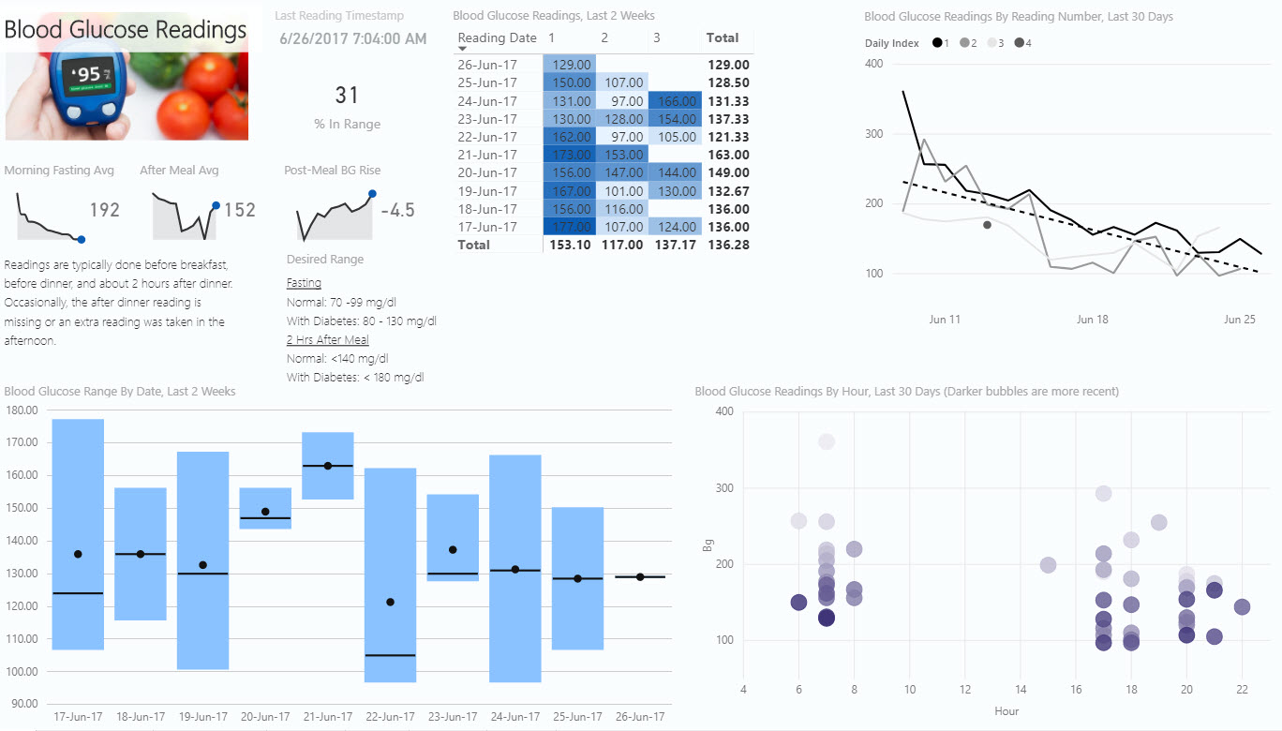
Power BI
Features
Easy to Use
Build for Speed
Can access lots of different data sources
Mix different sources on one page
Cross filtering
Highly Interactive
Let's you play with your data to show hidden insights
Great visualisations that makes your data look fantastic
You don't need to code
Maps with limited location details
Supports and aggregates larger data sets than excel
Constantly improving with a strong community

Slide 7
Power BI Versions
Desktop
PC application
Many data sources
Manual refresh
Can link to Cubes/Db/Files/Reports
License Free
PowerBI Report Server
Publish Desktop Files
Automated refresh
Secured like Reports
Included in our SQL Server
Print option
Cloud
Publish from Desktop
Sharing & Collaboration (Paid)
Free/Paid Pro (monthly)
Scheduled updates
Access to cloud services
Natural language input & insight generator
Full Screen Dashboard
Can Link Excel to Data
Mobile
Links to the Cloud Dashboards
Layouts optimised for Mobile
Interactive

Slide 8
Power BI Users
Viewer
Someone who just looks at prebuild Dashboards and interacts with them
Builder
Someone who creates a dashboard from either a prebuilt dataset such as a Cube or adds their own data. Add visualisations and calculations
Advanced Builder
Someone who creates the prebuild datasets and creates complex PowerBI models

Slide 9
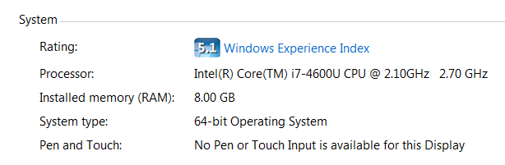
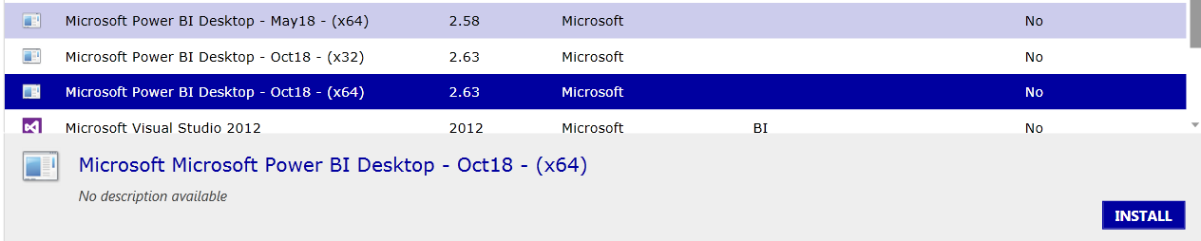

Getting Starting
Install PowerBI Desktop
Find which version you need
Right Mouse Button on My Computer
Properties
Check the Operating System Type (64bit or 32bit)
Externally download from
https://powerbi.microsoft.com/en-us/desktop/
Internally
goto http://sccm/getapps/
Select x64 for 64 bit Operating Systems and x86 for 32bit
Click Install (scroll right)
You should get a PowerBI icon

Slide 10
PowerBI Exercise
Get Data
Public data sets
https://www.ons.gov.uk/peoplepopulationandcommunity/leisureandtourism/datasets/monthlyoverseastravelandtourismreferencetables
https://www.ofx.com/en-gb/forex-news/historical-exchange-rates/monthly-average-rates/
https://www.visitbritain.org/inbound-tourism-trends

Slide 11
Exercise Videos
Start PowerBI Video 1 01:24
Download some sample Data Video 2 01:48
Get Data csv Video 3 01:44
Improve the Query Video 4 02:33
Improve the Query2 and Add Dates Video 5 04:03
Add More visuals Video 6 05:17
Add More visuals2 Video 7 04:02
Add Dax Calculations Video 8 07:59

Slide 12
Exercise Videos
Add Some Excel Data Video 9 8:29
Pivot the Data Video 10 2:23
Add Exchange Rate from Web Video 11 2:40
Add Date Table & Connect Data Video 12 3:10
Online Videos https://www.youtube.com/playlist?list=PLUIkYG_TQD7wkDrK7L8P7XnLPIl_G7Ugv
Documents
https://github.com/stretcharm/PowerBI_Training

Slide 13
A Few Best Practices
Understand and answer the question you or your users want answered
Name queries and name columns for business users. Use spaces
Remove unwanted columns and rows
Keep rows narrow
Use grid or format align visuals
Use the general format pane to set consistent sizes
Use the appropriate visualization for the data e.g. bar charts are better than pies
Don’t overload your dashboards with data or visuals

Slide 14

Questions

Slide 15
Online Training & Links
PowerBI Home
Free Desktop Download
Guided Learning 70 sessions about 8 mins each. Power BI Service (Cloud) training can be skipped.
EDx 6 week course (about 2-4 hrs/week). Free unless you want a certificate
Microsoft PowerBI YouTube Videos
Curbal YouTube Videos & Curbal Free Training
SQLBI DAX Free Training & Visual Reference Helps you pick an appropriate visualisation
List of useful Online Links

